Slide 1
Height Estimation and Person Detection
Group 1 - Evaluation 1
Daivat Bhatt (201501023)
Neel Shukla (201501063)
Rahulkumar Savariya (201501091)
Mohit Solanki (201501103)
Jeet Trivedi (201501111)

Slide 2
Project Developments
Previously, we were considering to use the fast-RCNN algorithm to detect humans in the frames.
However, on further experimentation and research, we found that the fast-RCNN (as well as faster-RCNN) is not only computationally heavier but sacrifices accuracy with speed.
We found that the YOLO algorithm was decently fast while also being accurate in its process of tracking and detecting a human.
We have also devised a plan to calibrate the camera on the campus premises, which we will use for height estimation.

Slide 3
YOLO Algorithm
The problem was mainly divided into 2 parts :
Detection of the Person from the video.
Track that Object through the span of entire Video
Notes:
NEEL

Slide 4
Components
Object Localization
Object Detection using Convolutional Implementation of Sliding Windows
Intersection Over Union
Non-max Suppression
Anchor Boxes

Slide 5
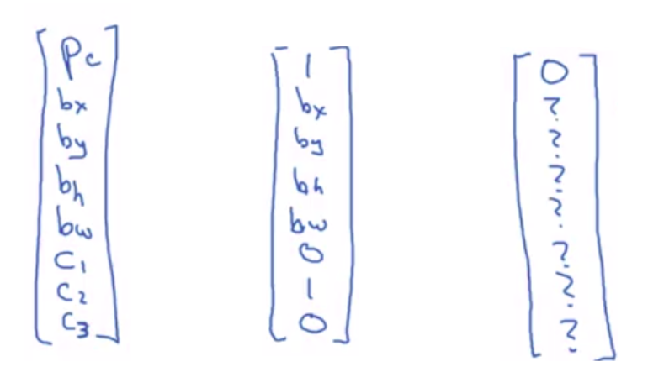
Object Localization
First objective in the video frame is how to represent an object when detected in a video frame. Assume for now that you would like to detect 3 objects c1, c2, c3 being car, motorbike and pedestrian.
In the images shown above the image to the left shows how to represent an object when it is detected. It will be a 1x8 row vector
Pc : whether object is there in the image
bx : X co-ordinate of the bounding box
by : Y co-ordinate of the bounding box
bh : Fraction of Height of the bounding box w.r.t the grid cell
bw : fraction of Width of the bounding box w.r.t the grid cell
c1,c2,c3 : 0 or 1 (1 if detected)
Hence the image in the middle shows if the motorbike is detected in image and image to right shows if no object is detected in the image.

Slide 6
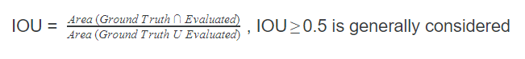
Object Detection using Sliding Windows
It takes a grid cell in the image of a particular size and checks for the existence of an object in those grid cells and notes down the bx, by, bw, bh values.
Intersection Over Union (IOU)
Normally there is always a deviation between the ground truth bounding box and the evaluated bounding box. We use IOU to solve this issue.

Slide 7
Non-max Suppression
The same object can be detected in multiple grid cells. What it does is take the bounding box with the highest accuracy of that object detected in the image will be taken into consideration. Thereby taking the most accurate detection.
Anchor Boxes
If the bounding boxes of the detection of the objects overlap, anchor boxes are used. Object Detection occurs normally and then IOU is calculated w.r.t. the anchor boxes. These are usually hand designed bounding boxes. And now the object localization matrix will be a 1x(m*8) matrix; m being the number of anchor boxes defined.

Slide 8
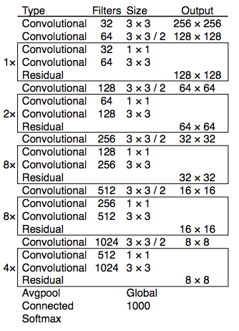
We applied the YOLO algorithm to test dataset by using pre-trained weights “tiny-yolo-voc-1c.cfg”.
A python wrapper on Darknet-53 (53 Layered CNN) was used.

Slide 9
Tracking Using Kalman Filter (Single Object)
A Kalman Filter is basically a tool that helps us to predict values. What our objective now was to essentially fill in the gaps between the detections that the YOLO algorithm wasn’t able to do. The object should be tracked in each frame of the video. It is a 2 step process :
Predict
Update

Slide 10
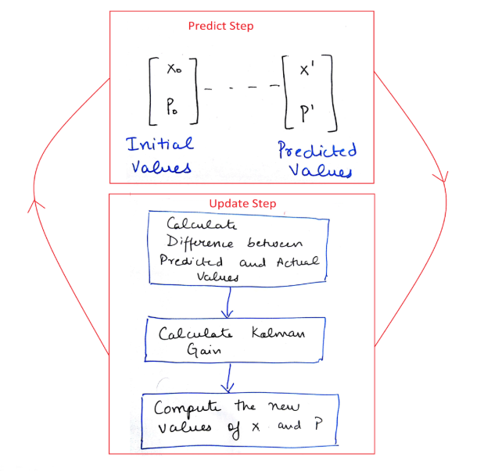

Slide 11
Predict Step : Here, we predict the new value called predicted value based upon the initial/previous value and then predict the uncertainty/error in our prediction according to the various measurement noise present in the system.
Update Step : Here, we take in account the actual measurement coming from the device and we call this as measured value. Here we calculate the difference between our predicted value and measured value and then decide which value to keep by calculating the Kalman Gain. We then calculate the new value and new error based on our decision made by Kalman Gain. These calculated values will finally be the predictions done by our Kalman Filter in iteration 1.
The output of the update step is again fed into the Predict State and the cycle continues until the error between our predicted and actual values converge to zero.

Slide 12
Tracking (Multiple Objects)
While tracking a single person in the video frame, it was simpler to get the track of a particular person. When it comes to multiple objects, the problem of ID-ing each object comes on to the surface. Each object’s position needs to be kept in track of in each frame. That can can be done by using Hungarian Algorithm. Hungarian Algorithm assigns each object to their particular track ID. and then tries to track the predictions it gets from the Kalman filter, similarly.

Slide 13
Results of Person Detection
We were accurately able to create a bounding box over a person detected from the video captured on the video camera near the main gate of our campus.

Slide 14
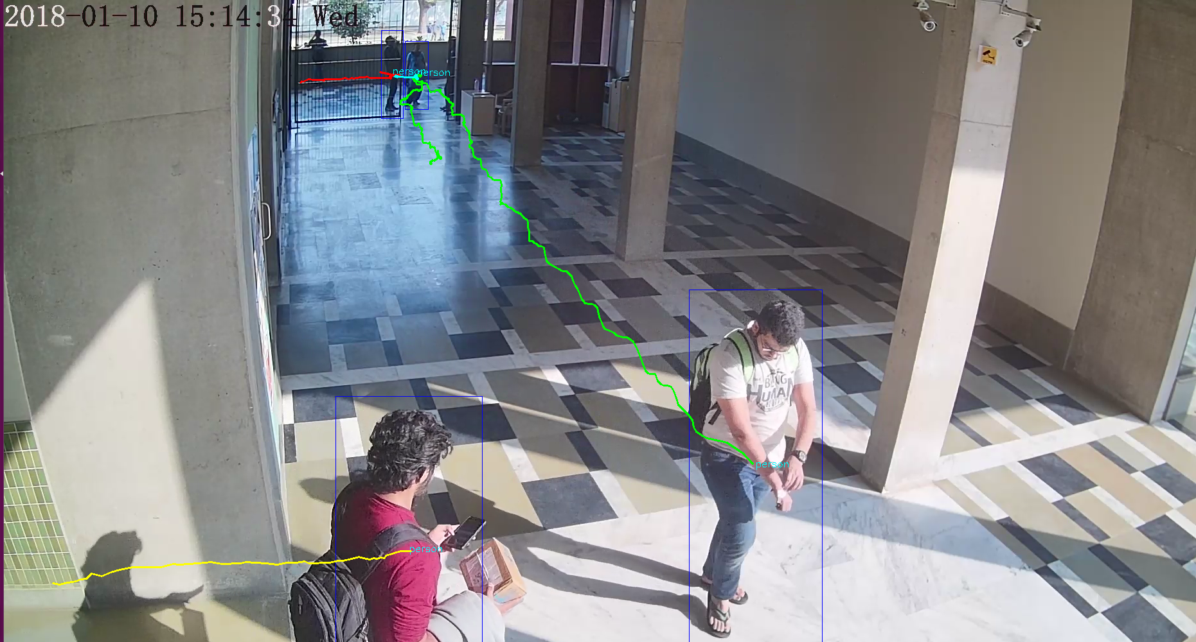

Slide 15
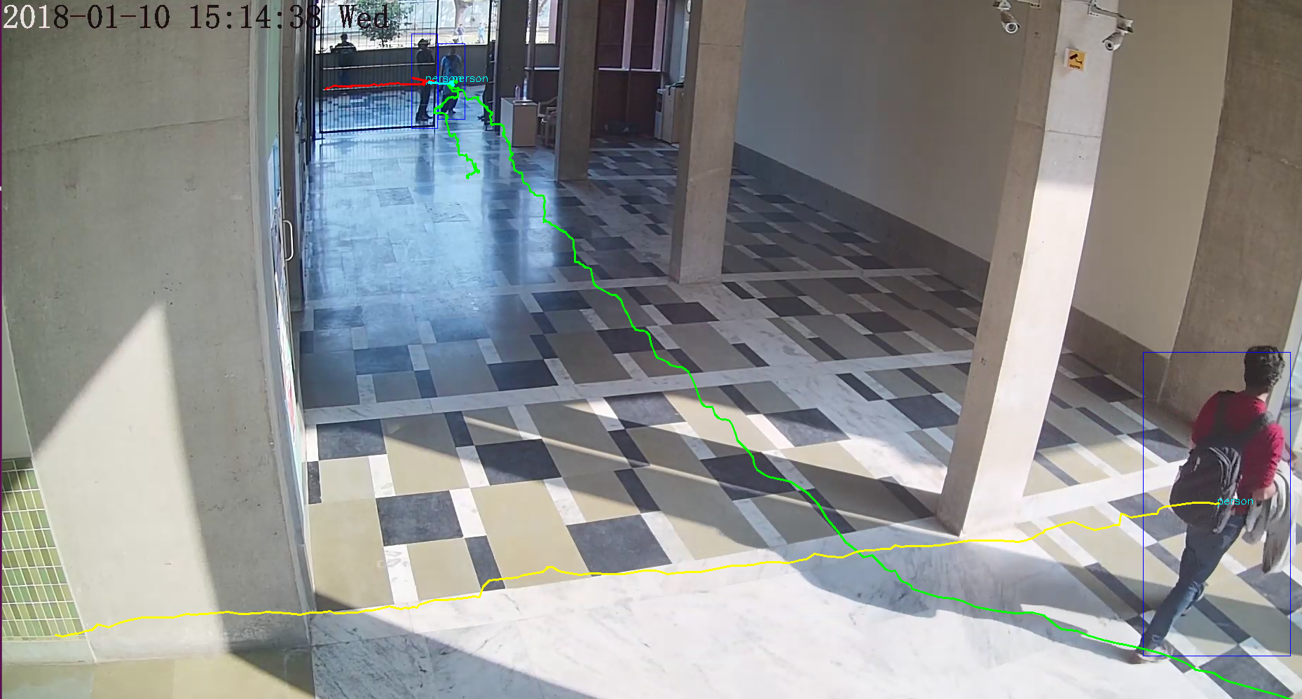

Slide 16
Future Work
Work on calibrating camera and obtaining intrinsic and extrinsic parameters of the surveillance camera.
Estimation of height using the parameters obtained from camera calibration and bounding box.
Experimentation on height estimation under different condition of illumination and clothing color.

Slide 17
References
E. Jeges, I. Kispal and Z. Hornak, "Measuring human height using calibrated cameras," 2008 Conference on Human System Interactions, Krakow, 2008, pp. 755-760.doi: 10.1109/HSI.2008.4581536
E. Jeges, I. Kispal, "Human height estimation using a calibrated camera", Oldweb.mit.bme.hu. N. p., 2018. Web. 15 Oct. 2018.
Redmon, Joseph et al. "You Only Look Once: Unified, Real-Time Object Detection." Cv-foundation.org. N. p., 2016. Web. 15 Oct. 2018.

